Slide 1
Secondary structures of the proteins

Slide 2
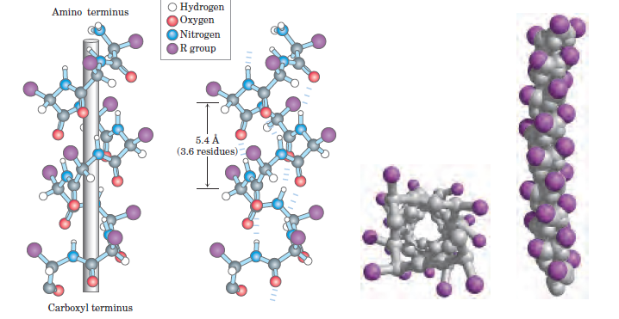
Α-Helix

Slide 3
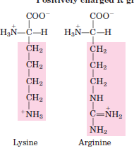

Amino acids propensity
Group of positive or negative charged residues break helix at pH 7

Slide 4
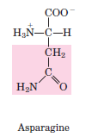
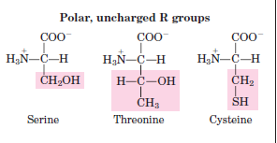
Bulk of Asn, Ser, Thr and Cys also destabilize if close

Slide 5
Ion pairs are located almost three residues away
Eg
A positive charged residue is almost three residues away from a negatively charged residue

Slide 6
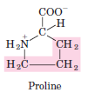
Two hydrophobic or aromatic residues are also three residues away to form a hydrophobic interactions
Constrains Pro and Gly
Rotation of N__C is impossible
Gly is bit more flexible its helix is different

Slide 7
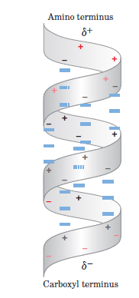
Dipole in helix

Slide 8
Summary
Stability of a-helix depends on five factors
Attraction/repulsion between R group of successive residues
Bulkiness and charge of R
Interaction of first and fourth R group
Occurrence of Pro or Gly
Interaction of the residues at terminal

Slide 9
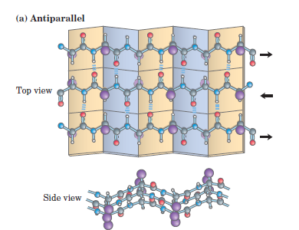
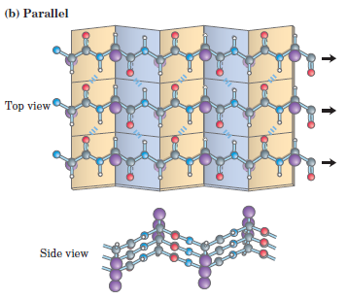
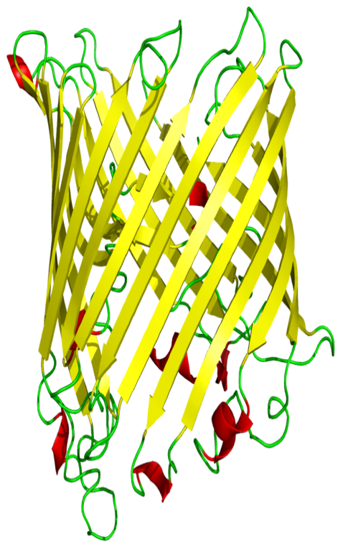
B-Sheets

Slide 10
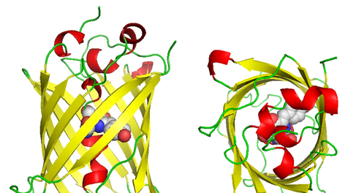

Slide 11
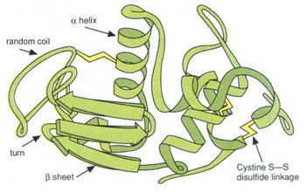

Slide 12
